Slide 1
[Organisation] · PHASE B
Process Flow
Twenty-two processes across seven value streams, and the 1.19 million quotations with no needs analysis behind them
22 processes · 7 value streams · 6 wholly manual
Draft 0.1 · September 2027

Slide 2
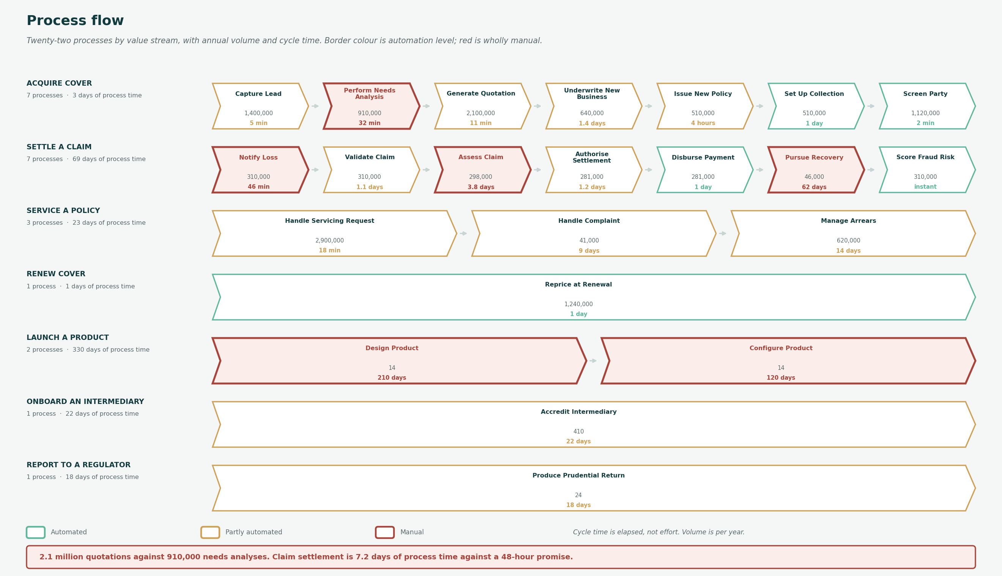
THE FLOW
22 processes across 7 value streams
Border colour is automation level. Volume is per year and cycle time is elapsed, not effort.

Slide 3
ACQUIRE COVER
The acquisition funnel does not close
Volume between one step and the next. More quotations leave the process than leads enter it.
Capture Lead
1,400,000
5 min
Across four channel masters, each creating its own party record.
Perform Needs Analysis
910,000
-490,000
32 min
Fewer than leads. The FAIS record is produced by hand in 32 minutes.
Generate Quotation
2,100,000
+1,190,000
11 min
1.5 per lead. 1.19 million have no needs analysis behind them.
Underwrite New Business
640,000
-1,460,000
1.4 days
Under a third of quotations reach underwriting.
Issue New Policy
510,000
-130,000
4 hours
Four in five underwritten cases issue.
Set Up Collection
510,000
0
1 day
Every issued policy gets a mandate. Fully automated.
FAIS requires a needs analysis before advice. Either most quotations are execution-only and nothing records that, or advice is given without the record.

Slide 4
BY STREAM
Seven value streams
Process count, total process time and the volume entering each stream.
Acquire Cover
7
3 days
2,100,000
Capture Lead → Perform Needs Analysis → Generate Quotation → Underwrite New Business → Issue New Policy → Set Up Collection → Screen Party
Settle a Claim
7
69 days
310,000
Notify Loss → Validate Claim → Assess Claim → Authorise Settlement → Disburse Payment → Pursue Recovery → Score Fraud Risk
Service a Policy
3
23 days
2,900,000
Handle Servicing Request → Handle Complaint → Manage Arrears
Renew Cover
1
1 days
1,240,000
Reprice at Renewal
Launch a Product
2
330 days
14
Design Product → Configure Product
Onboard an Intermediary
1
22 days
410
Accredit Intermediary
Report to a Regulator
1
18 days
24
Produce Prudential Return
Launching a product takes 330 days across two manual processes, for fourteen products a year.

Slide 5
FINDINGS
What the flow shows
One point one nine million quotations have no needs analysis behind them
2.1m quotations against 910,000 needs analyses, from 1.4m leads.
FAIS requires a needs analysis before advice is given. Either most quotations are execution-only and not advice, in which case nothing records that distinction, or advice is being given without the record. The process model cannot tell the two apart, and that is the gap.
Claim settlement takes 7.2 days of process time against a 48-hour promise
Notify 46 minutes, validate 1.1 days, assess 3.8 days, authorise 1.2 days, disburse 1 day.
The measured median is 11 days, so 3.8 days sit between the steps and are modelled nowhere. Even if that waiting were eliminated, the process as designed takes more than three times the promise. The promise is not a process problem to be tuned; it is a design that cannot meet it.
Two manual steps consume about four hundred full-time equivalents
Needs analysis at 32 minutes across 910,000 cases and loss notification at 46 minutes across 310,000.
723,000 hours a year, or roughly 402 people at 1,800 hours. Both are the first human touch in their value stream, and both are entirely manual.
Launching a product takes 330 days across two manual processes
Design at 210 days and configure at 120 days, for fourteen products a year.
Configuration is the half that a product catalogue removes, and it is the half already carried by WP-08. Design is manual, 210 days, and in no work package.
Pursue Recovery runs 62 days, manually, on 46,000 cases a year
The longest cycle time in the estate after product design, and the only one in the claims stream that is wholly manual.
It is also tracked in a spreadsheet outside the claims system, which the data migration found. A 62-day manual process handling recoveries is where money is lost quietly rather than visibly.
Cycle time is elapsed, not effort. Only the minute-scale steps can be read as hands-on work, and those two alone are about 402 full-time equivalents.

